Slide 1

Intel® Unnati Industrial Training 2025: Bug Detection and Fixing
Name: Sneha Das
College Name: Brainware University

Slide 2
Project Overview
Core Technologies
Additional Tools
Python
Scikit-learn
Transformers (Hugging Face)
Flake8
Torch (PyTorch)
Pandas
Datasets (Hugging Face)
The project utilizes a range of technologies, including Python as the core programming language, Transformers from Hugging Face for pretrained models, and Torch (PyTorch) as the deep learning framework. Additional tools such as Scikit-learn, Flake8, Pandas, and Datasets from Hugging Face are also employed.

Slide 3
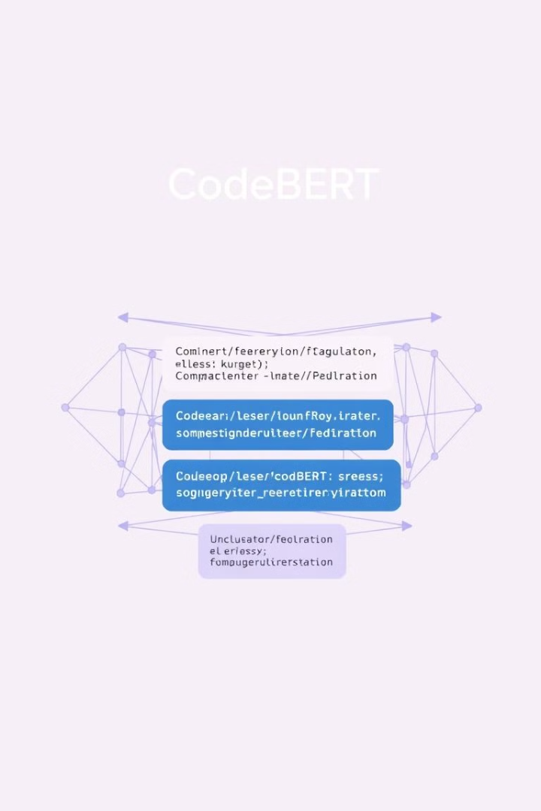
Machine Learning Model: CodeBERT
Model Basis
Code Classification
RoBERTa-based model by Microsoft
Effective for categorizing code snippets
Bug Detection
Identifies potential bugs in code
CodeBERT, a RoBERTa-based model developed by Microsoft, is used for understanding programming languages. It is particularly effective for code classification, bug detection, code summarization, and code completion. The model is trained on large-scale code repositories.

Slide 4




Implementation Details: Data Preparation & Tokenization
Data Preparation
Create dataset with labeled text samples (Positive, Negative, Neutral) in a CSV file.
Numerical Mapping
Map text samples to numerical labels for model training.
Tokenization
Use RobertaTokenizer from Hugging Face to preprocess code snippets.
The implementation involves data preparation, where a dataset containing labeled text samples is created and stored in a CSV file. The text samples are then mapped to numerical labels for model training. The RobertaTokenizer from Hugging Face is used to preprocess code snippets before feeding them into the model.

Slide 5

Implementation Details: Model Training
1
Dataset Loading
Load dataset into a Hugging Face Dataset and tokenize.
2
Fine-Tuning
Fine-tune RobertaForSequenceClassification model with the dataset.
3
Training
Train model using the Trainer class with defined hyperparameters.
The dataset is loaded into a Hugging Face Dataset and tokenized. The RobertaForSequenceClassification model is fine-tuned with the dataset. The model is trained using the Trainer class with defined hyperparameters such as batch size and epochs.

Slide 6
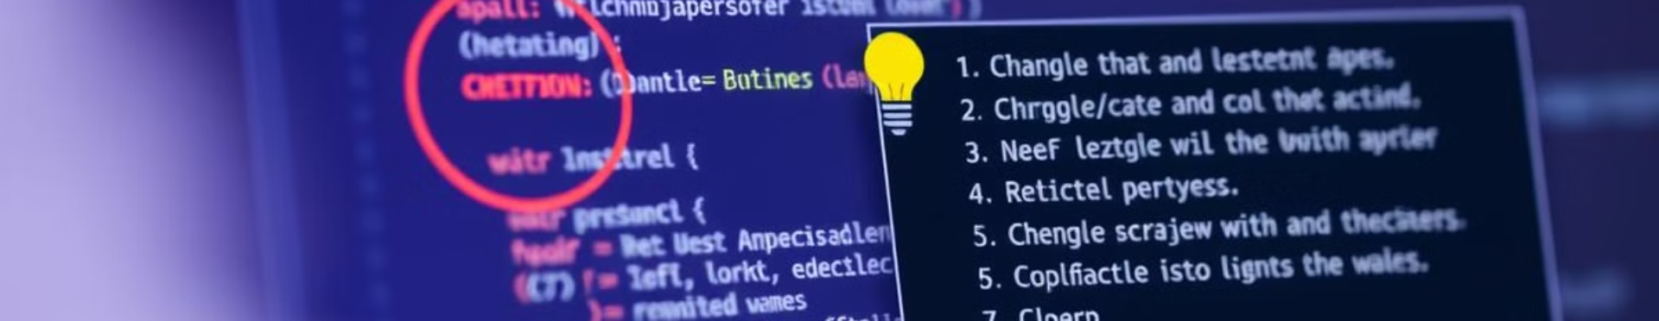


Bug Detection and Fixing Process
Bug Detection
Bug Fixing
Classify code snippets using the trained model.
Replace occurrences of "bug" with "fix".
The trained model is used to classify code snippets as containing a bug or not. Code snippets are tokenized and passed through the model to predict a label. A placeholder function replaces occurrences of the word "bug" with "fix" as a simplified approach.

Slide 7
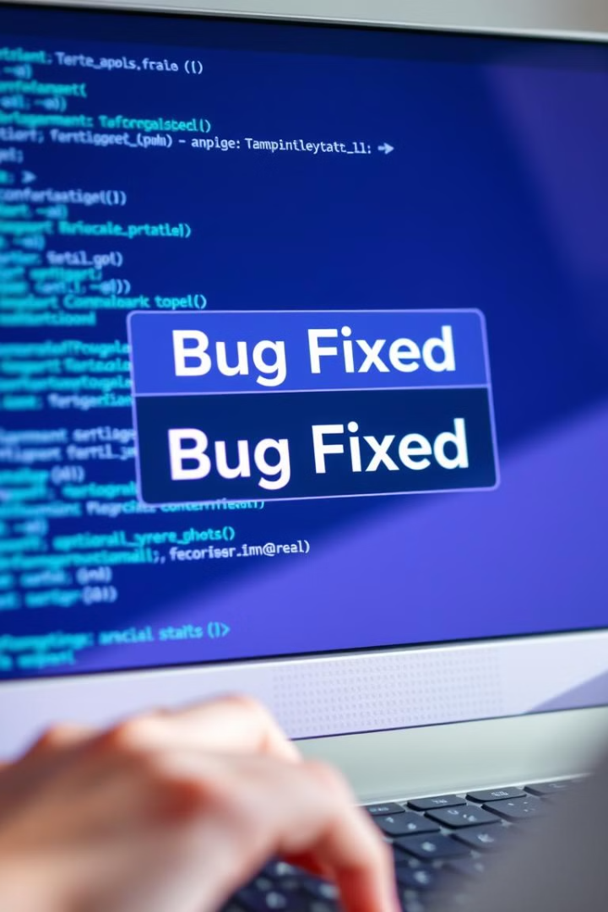
Expected Output and Future Enhancements
Bug Detected
No Bug Detected
Script prints "Bug detected!" and attempts to generate a corrected version.
Script prints "No bug detected."
Improve Fixing Logic
Use transformer-based code generation model.
If a bug is detected, the script prints "Bug detected!" and attempts to generate a corrected version. If no bug is found, it prints "No bug detected." Future enhancements include improving bug-fixing logic using a transformer-based code generation model and enhancing the dataset with more labeled buggy and fixed code examples.

Slide 8



Future Enhancements and Conclusion
Real-time API
1
Deploy as an API for real-time bug detection and fixing.
Enhanced Dataset
2
Enhance dataset with more labeled code examples.
Improved Logic
3
Improve bug-fixing logic using code generation.
Future enhancements include deploying the system as an API for real-time bug detection and fixing. The dataset can be enhanced with more labeled buggy and fixed code examples. The bug-fixing logic can be improved using a transformer-based code generation model.

Slide 9
Thank you

